Slide 1
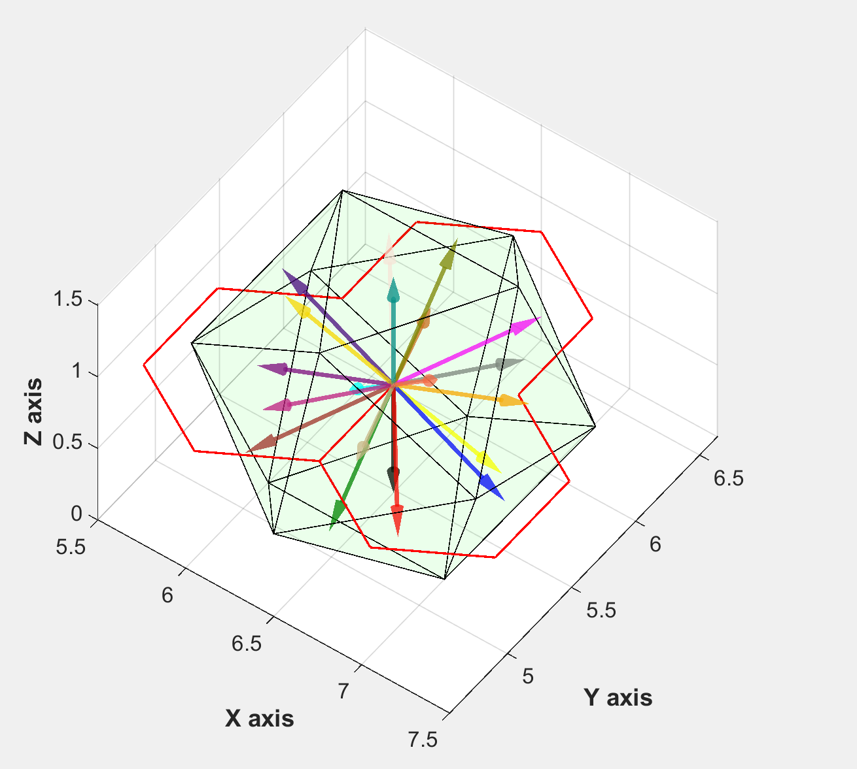

Slide 2
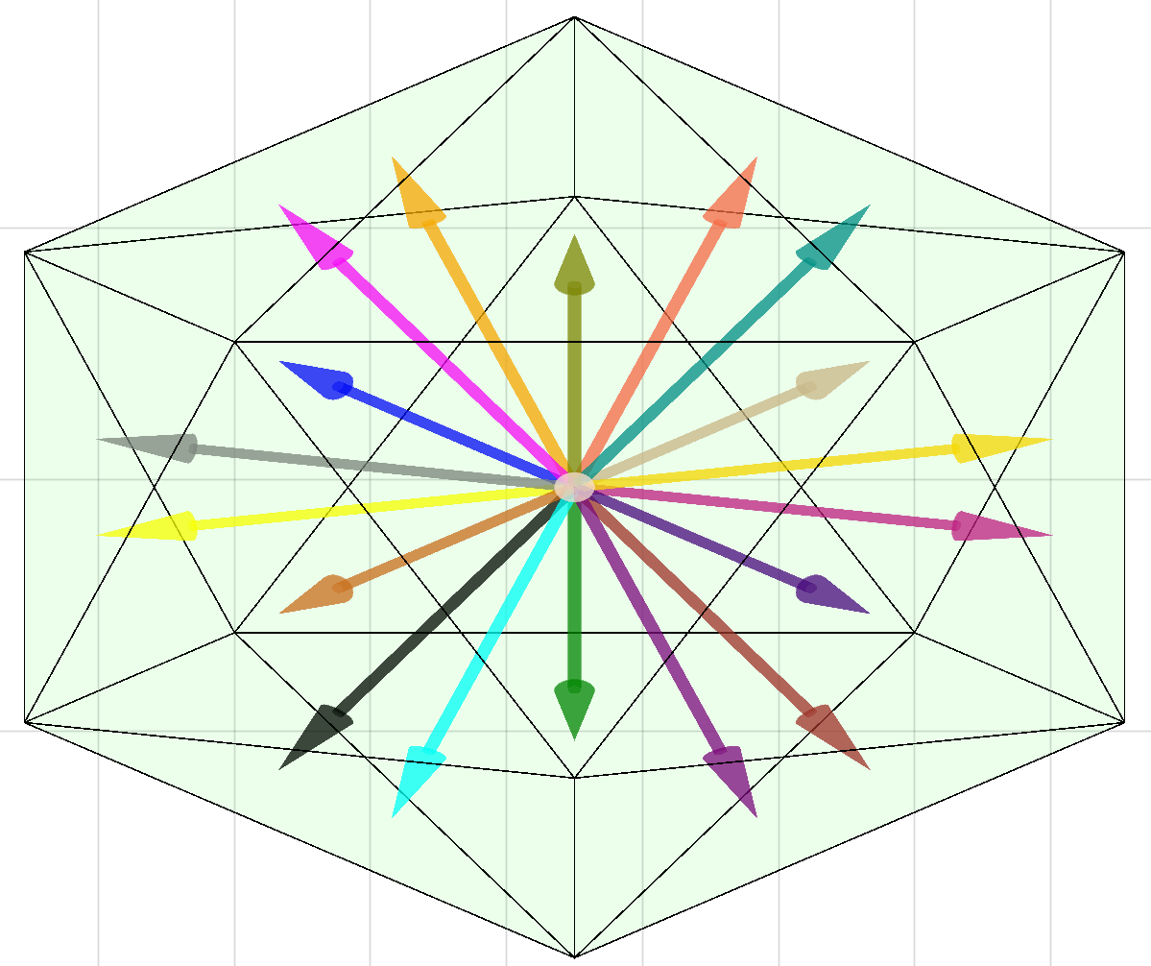
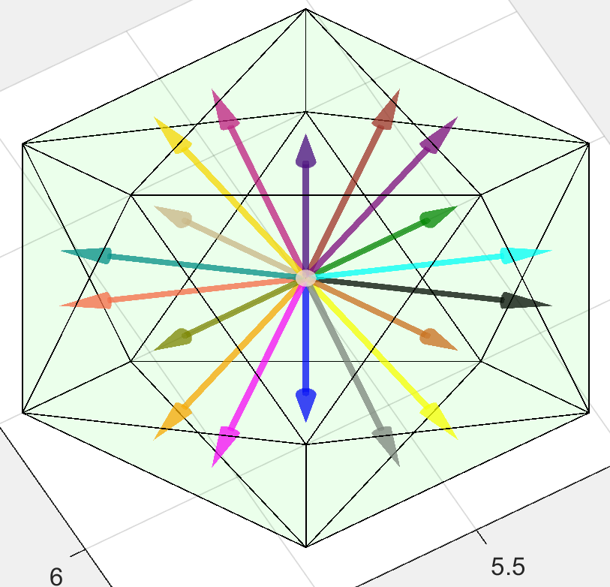
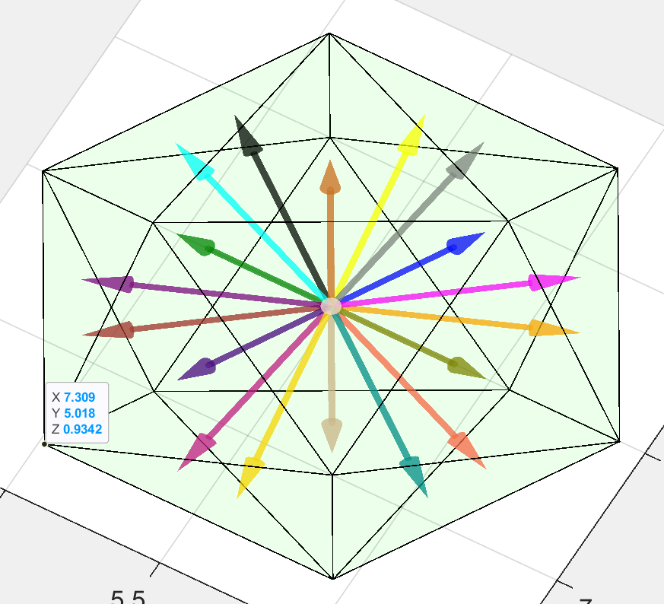
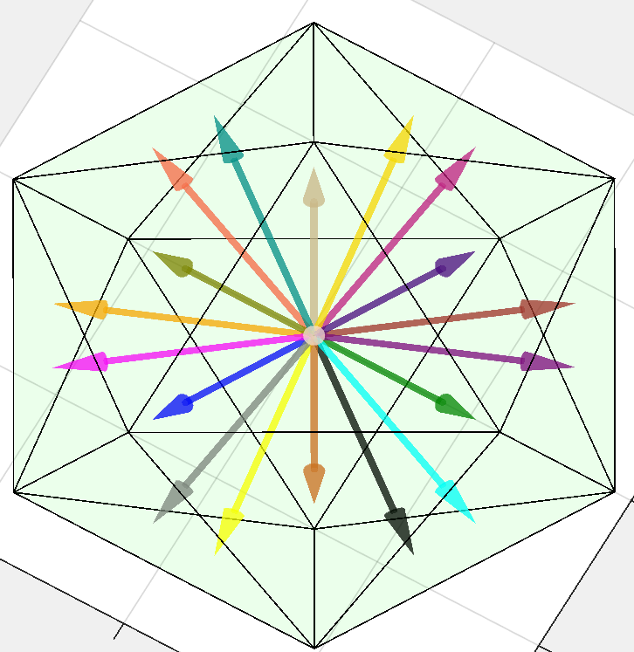
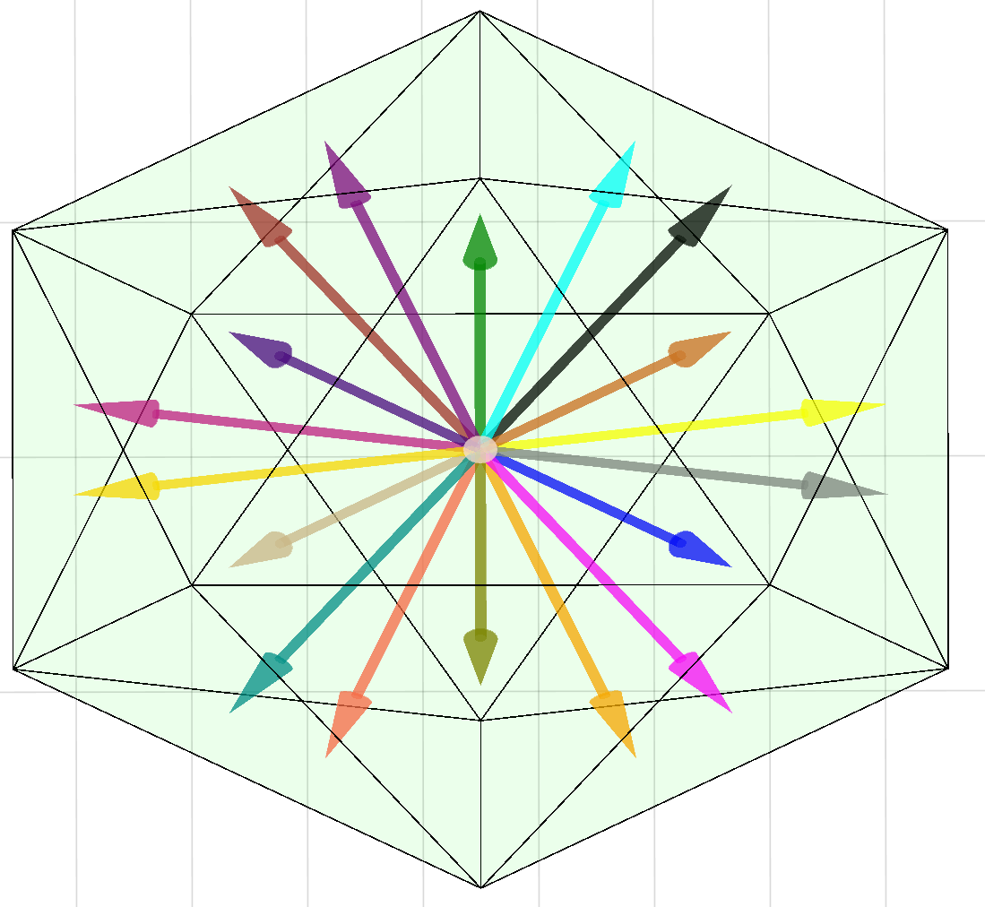
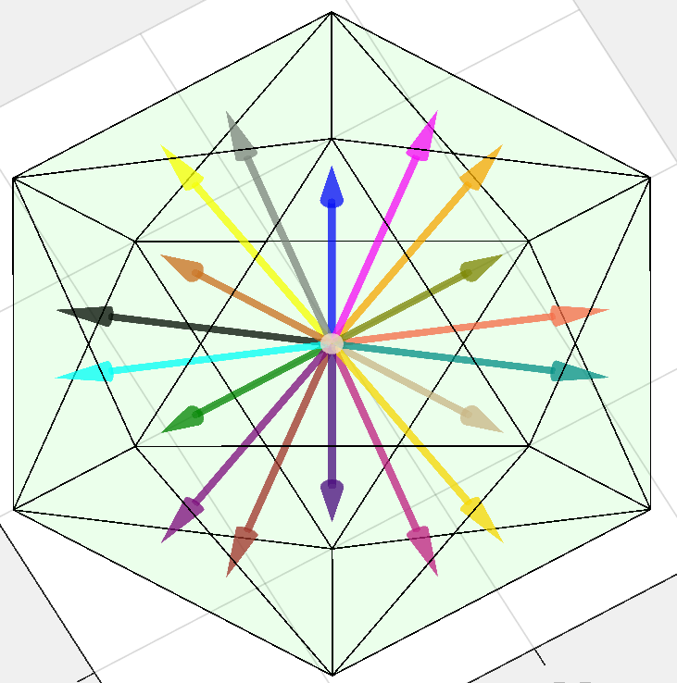
Red11
Red21
Red31
Red12
Red22
Red32

Slide 3
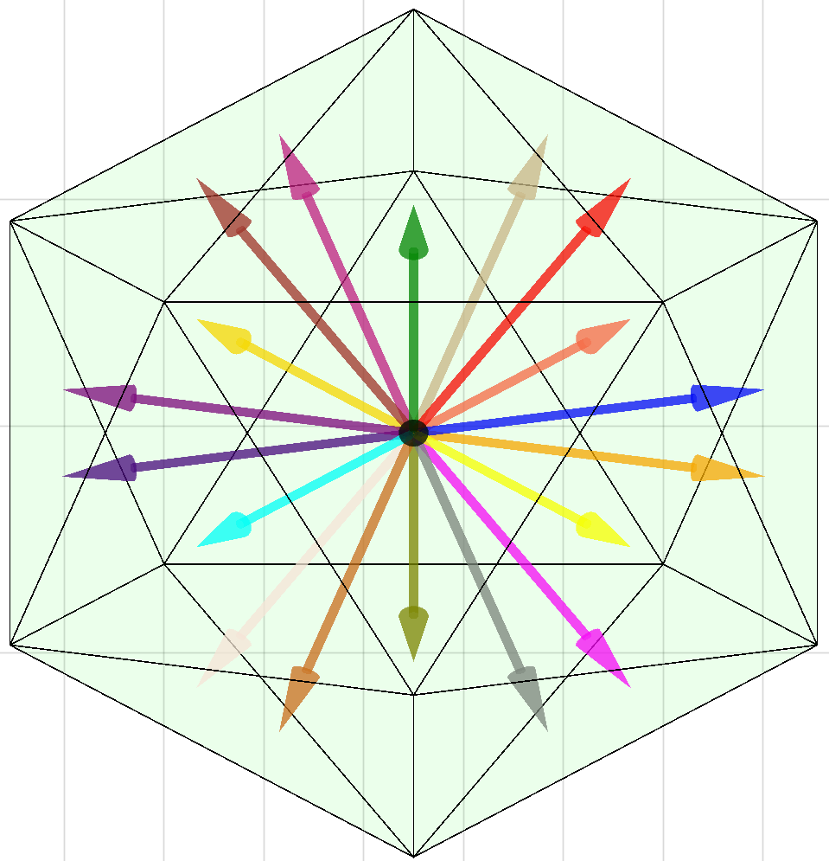
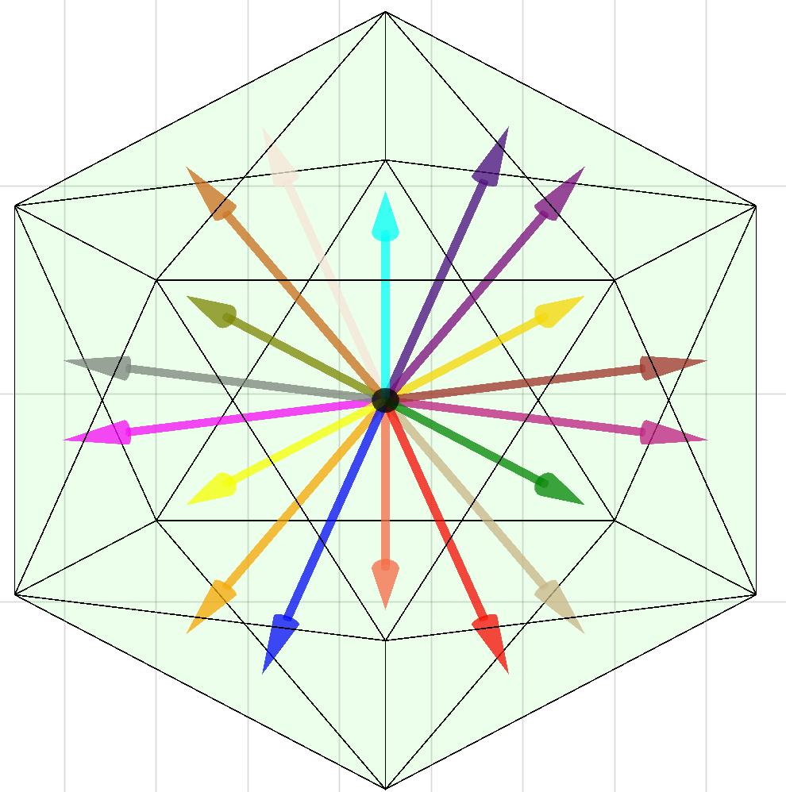
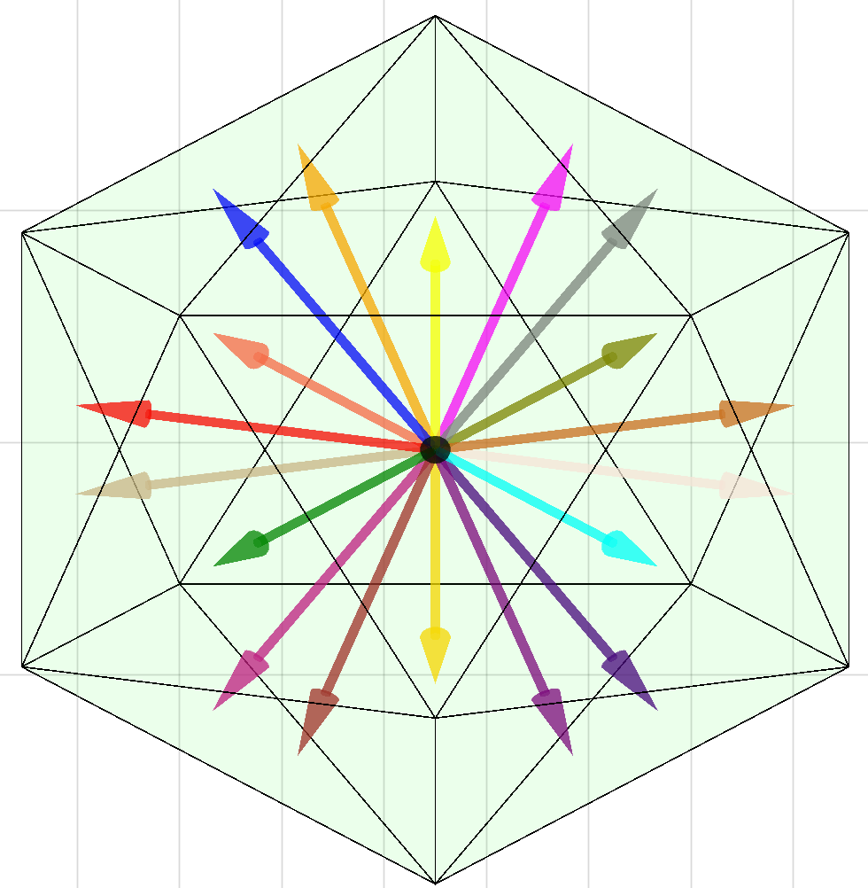
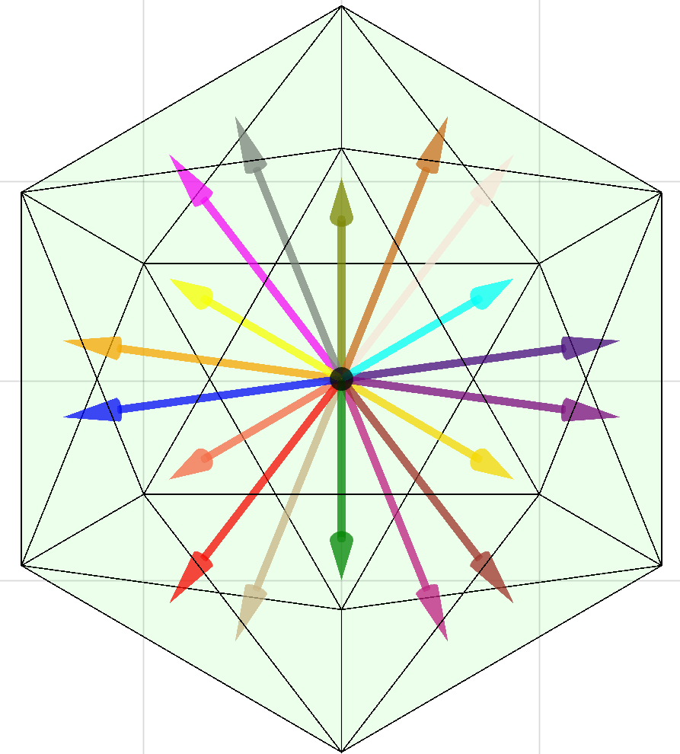
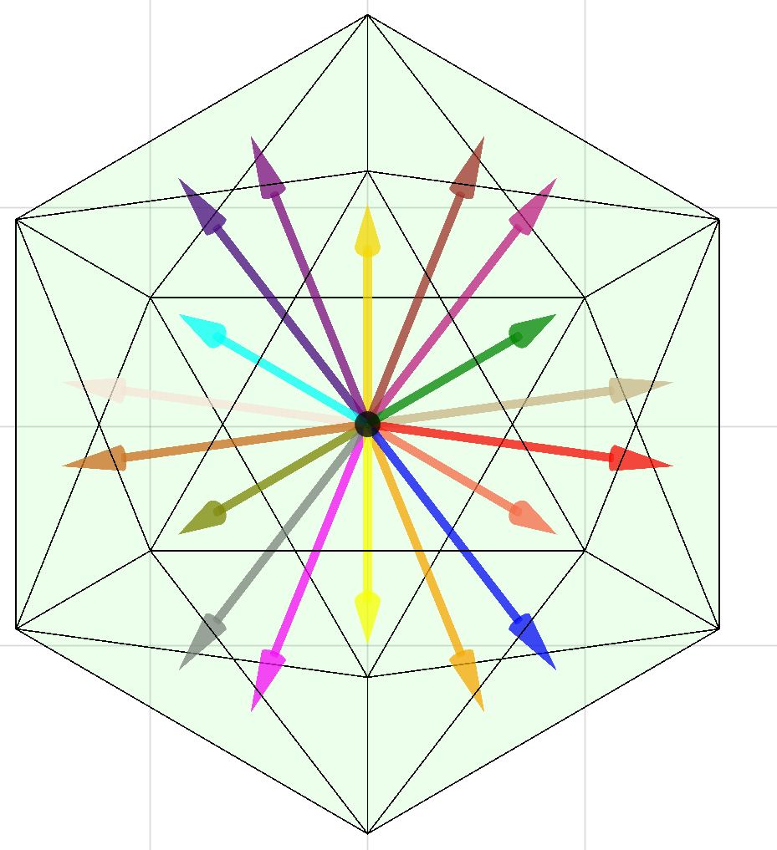
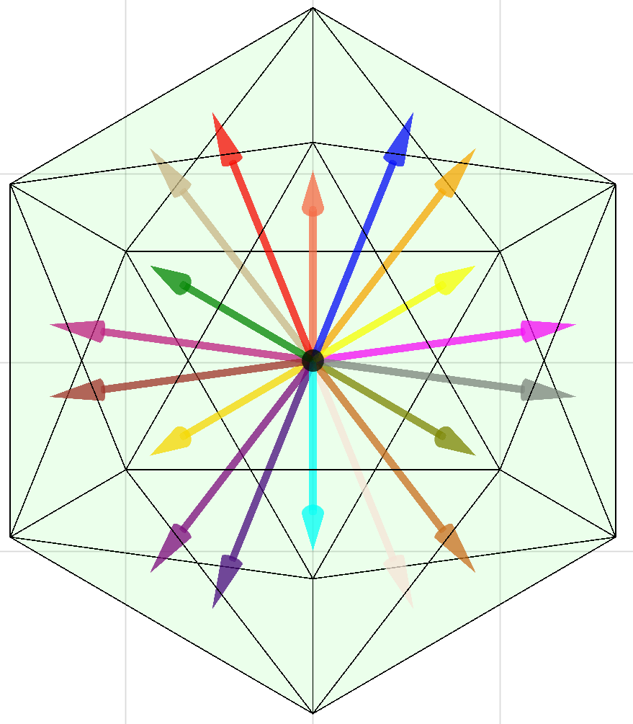
DarkCyan11
DarkCyan21
DarkCyan31
DarkCyan12
DarkCyan22
DarkCyan32

Slide 4
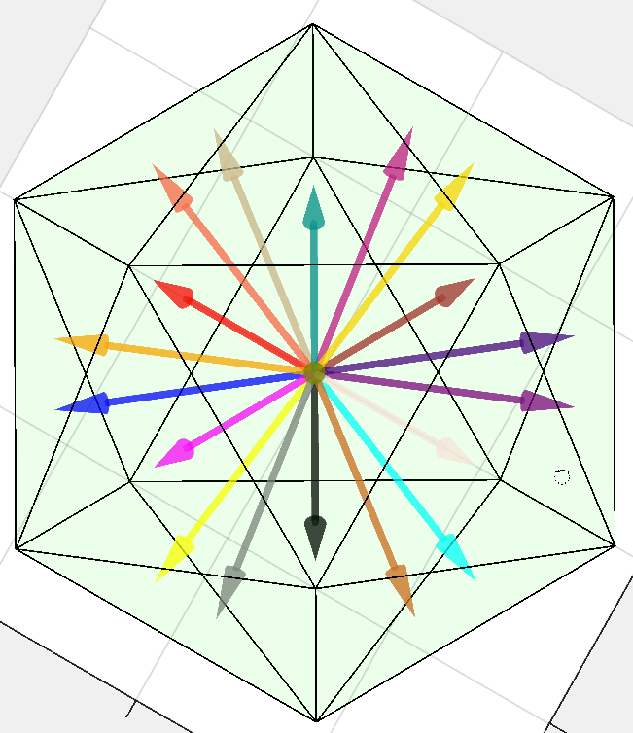
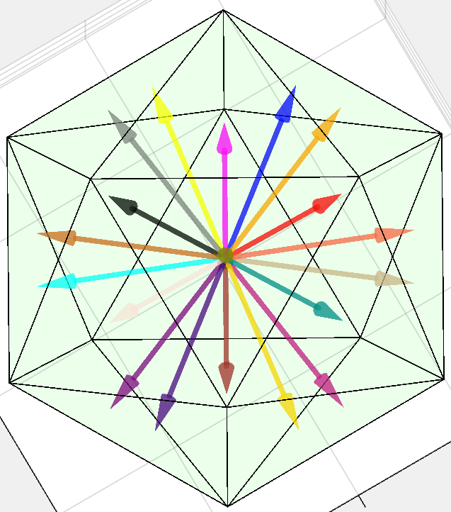
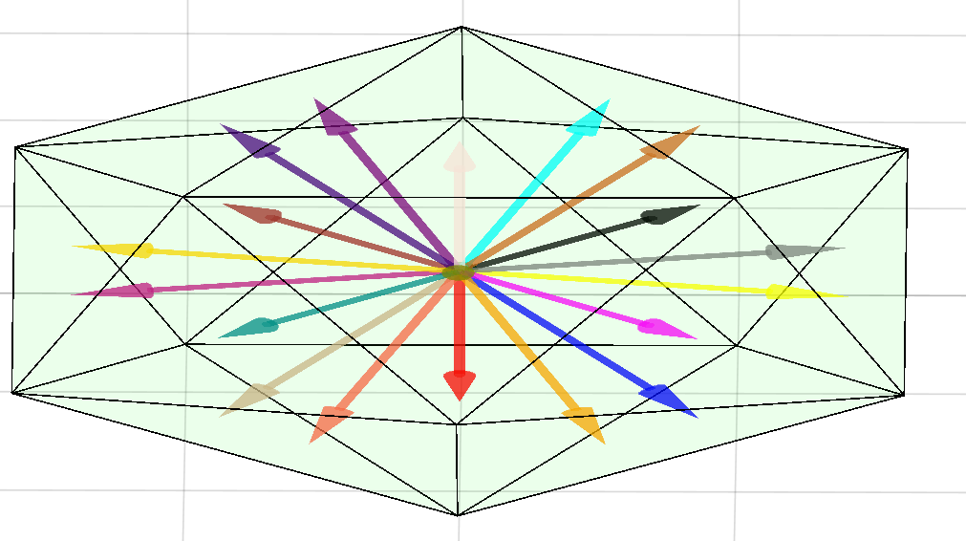
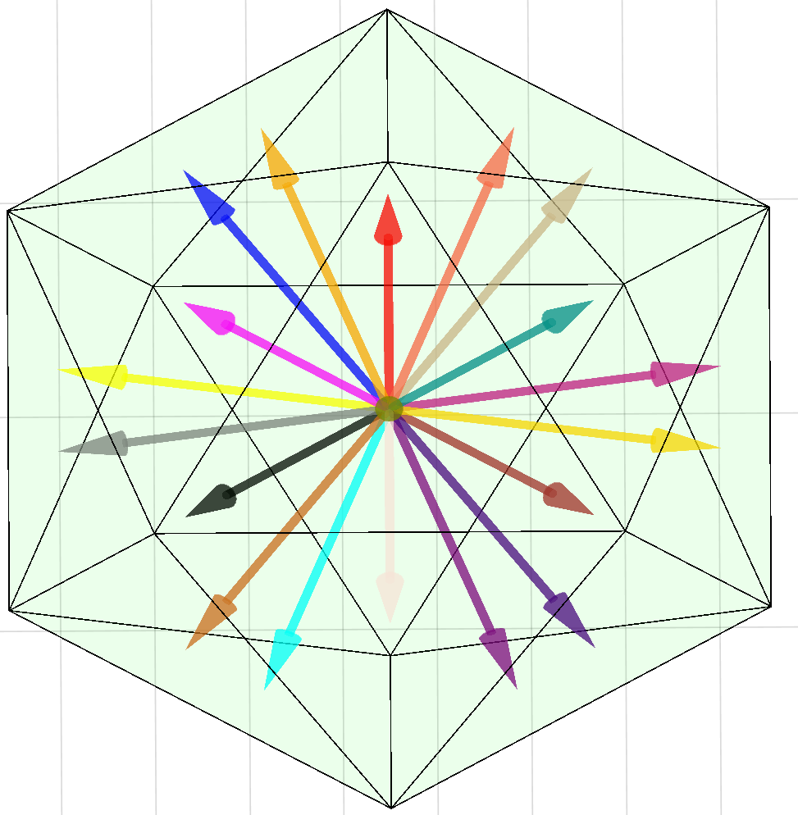
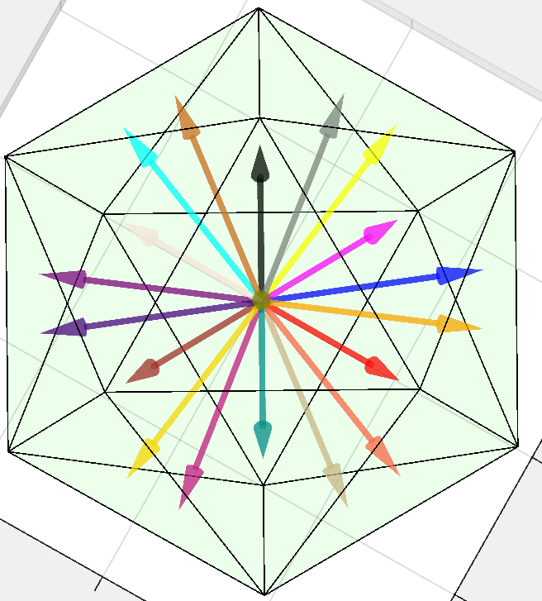
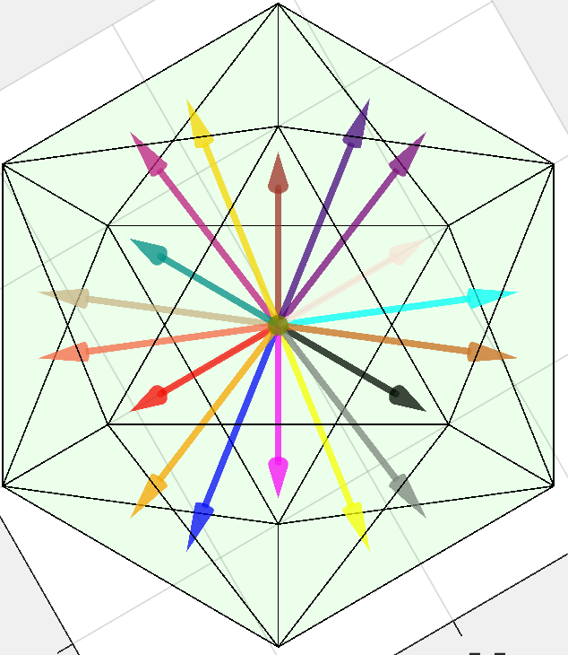
Green11
Green21
Green31
Green12
Green22
Green32

Slide 5
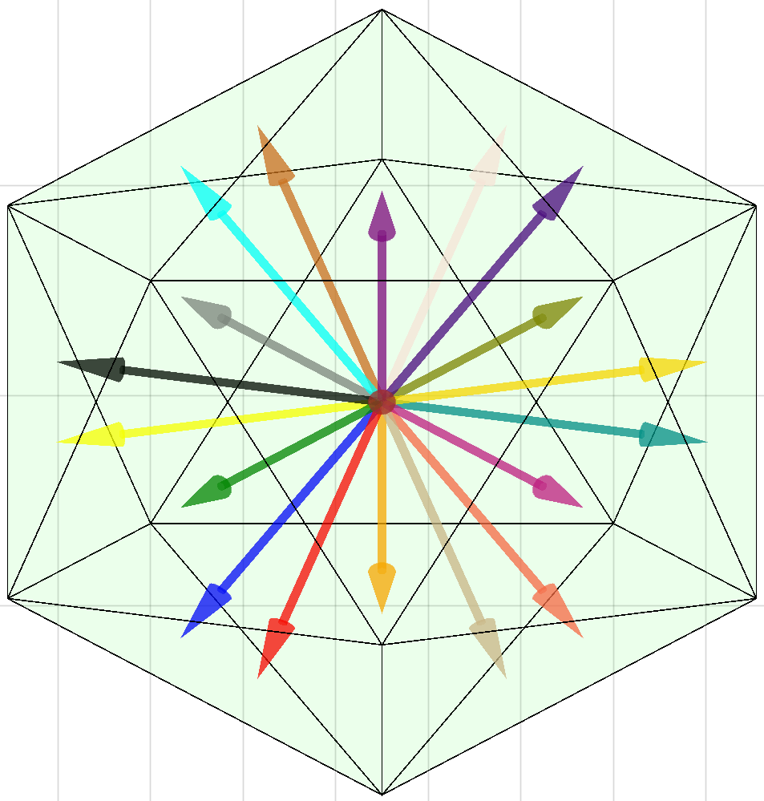
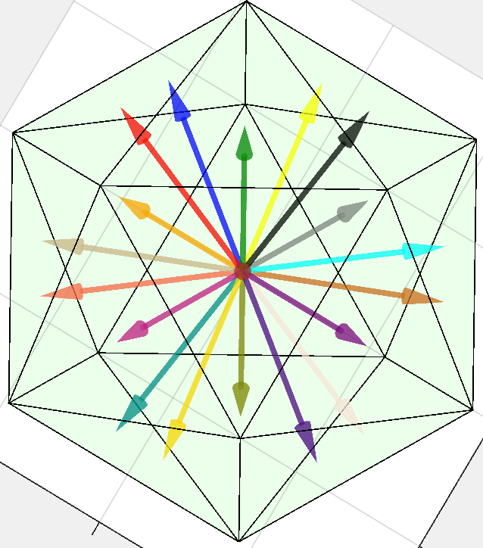
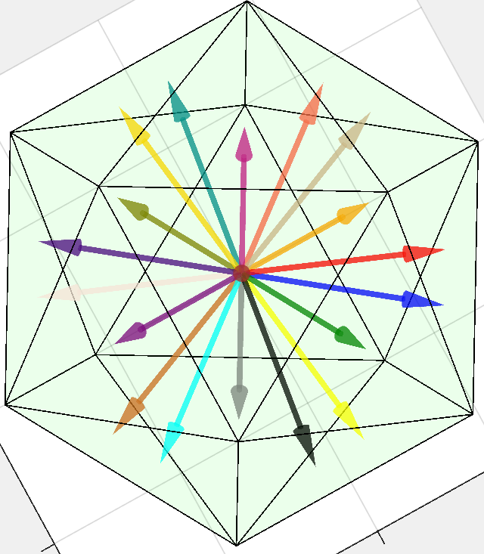
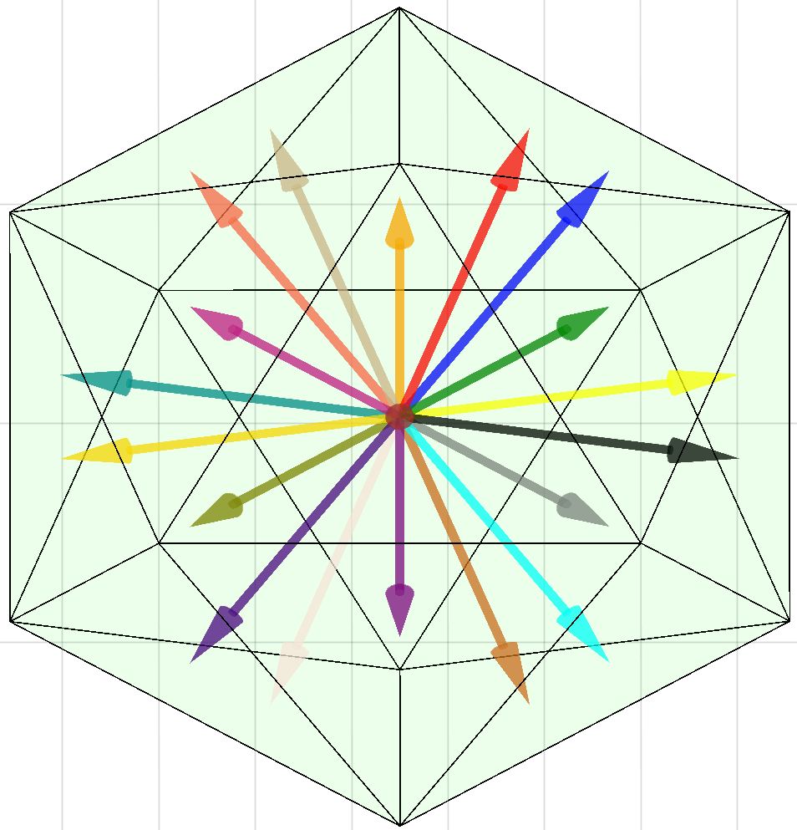
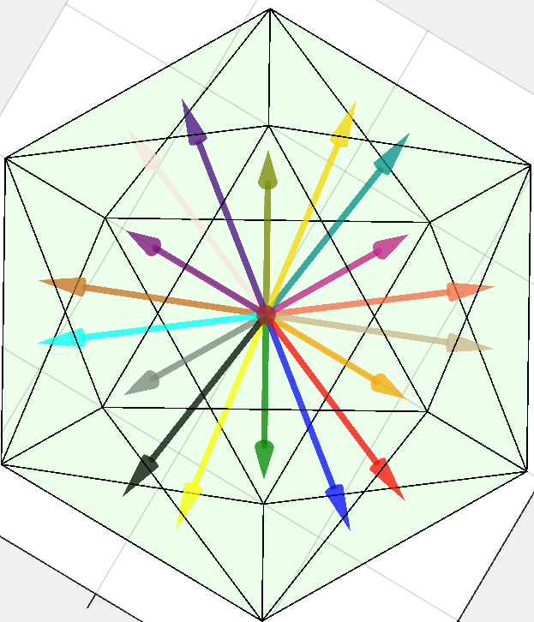
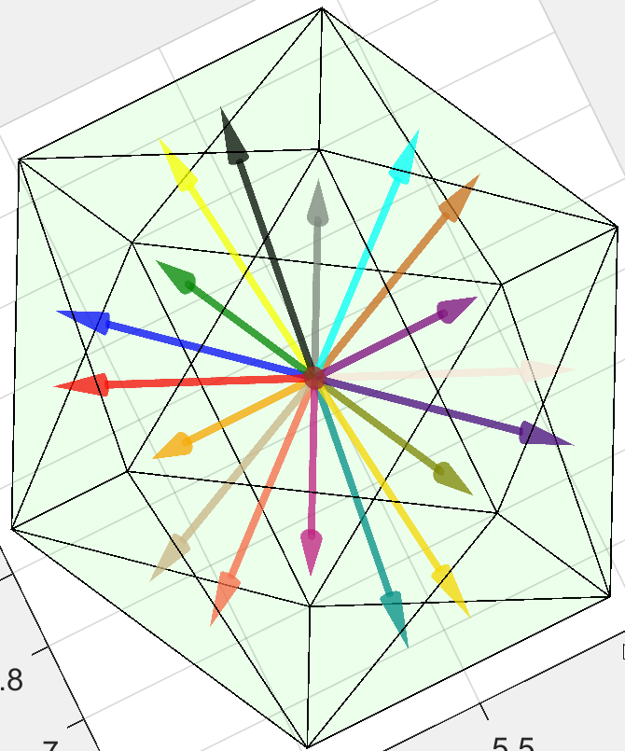
Magenta11
Magenta21
Magenta31
Magenta12
Magenta22
Magenta32

Slide 6
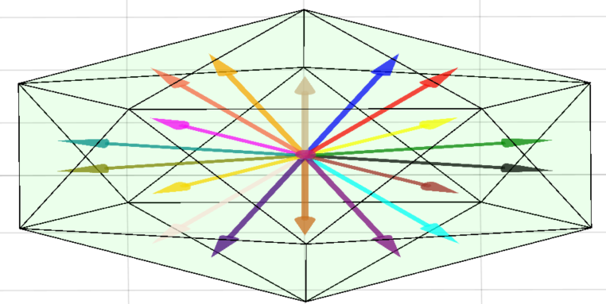
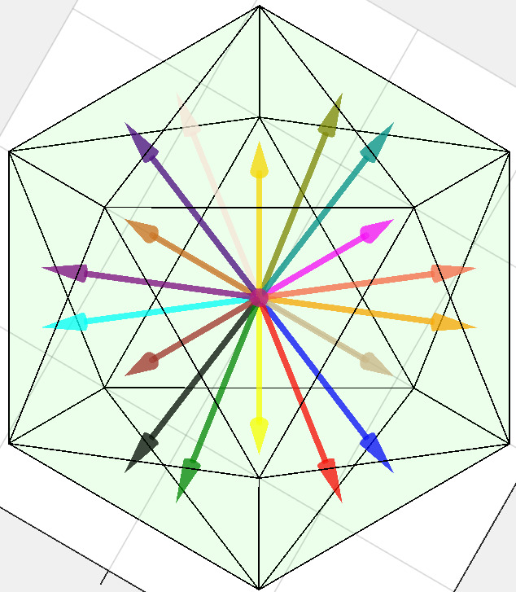
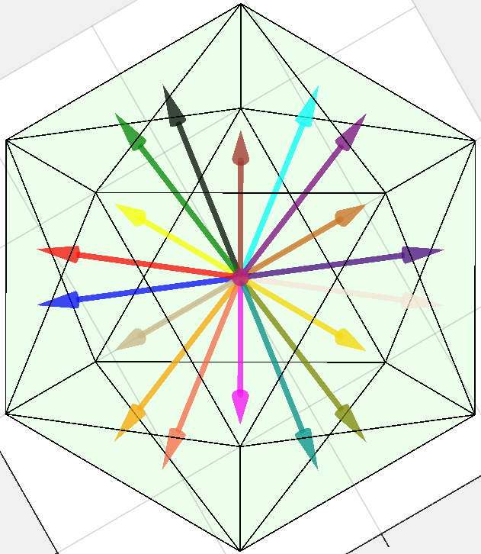
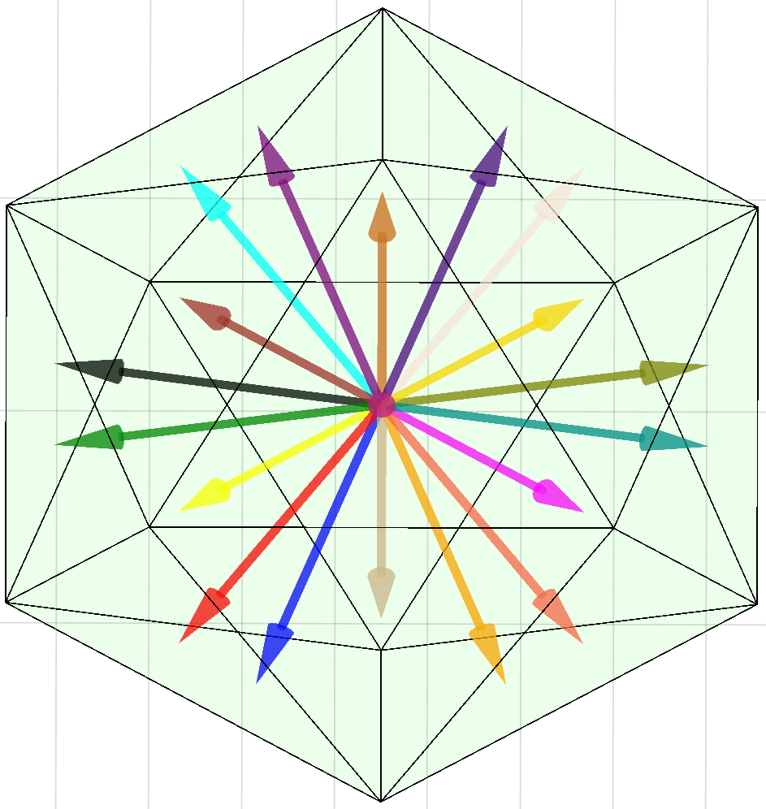
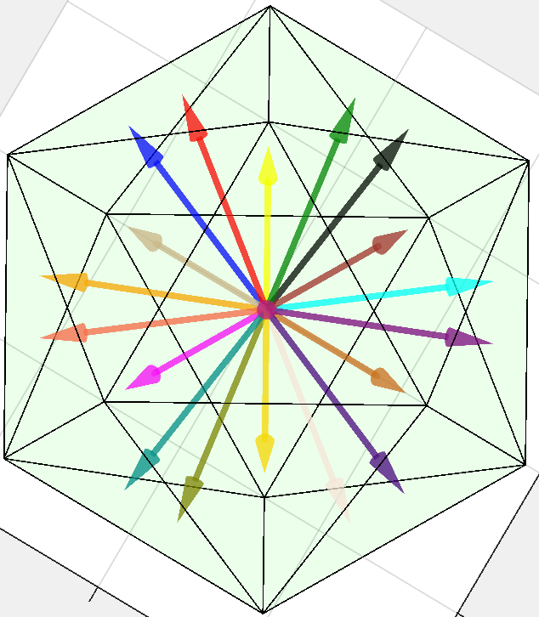
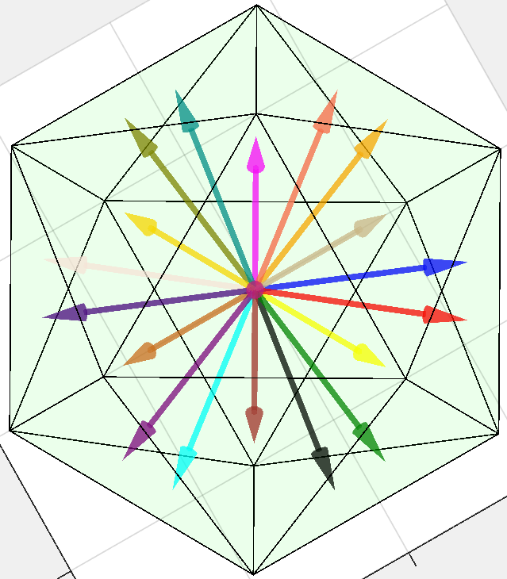
Grey11
Grey21
Grey31
Grey12
Grey22
Grey32

Slide 7
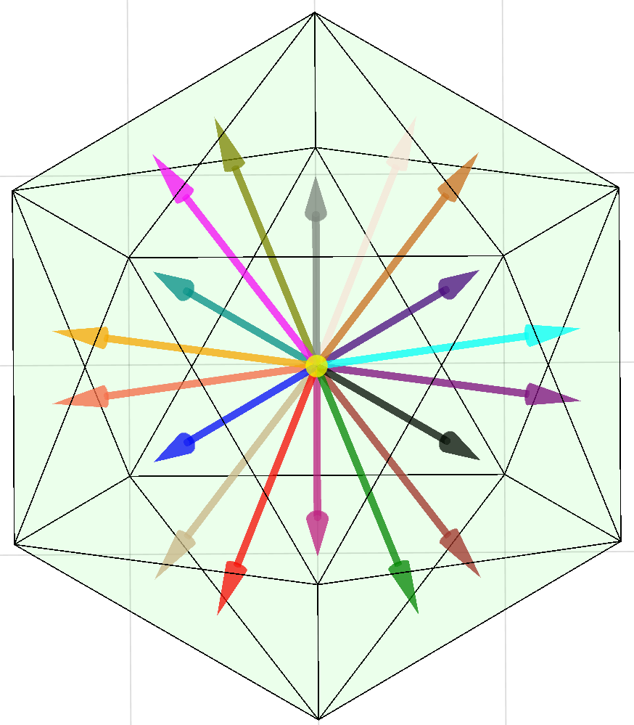
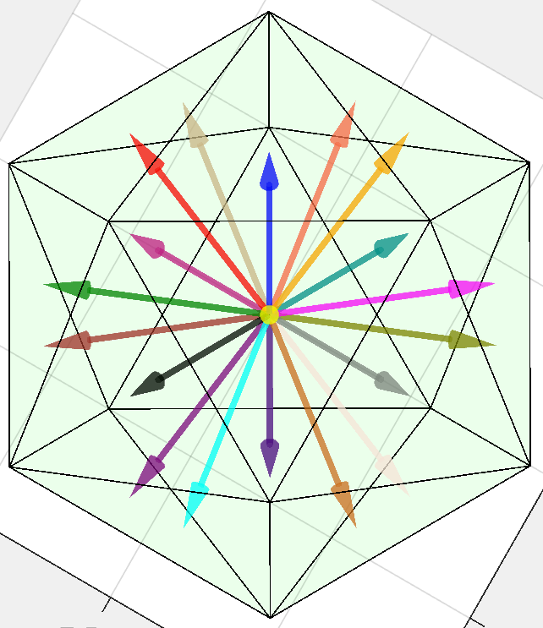
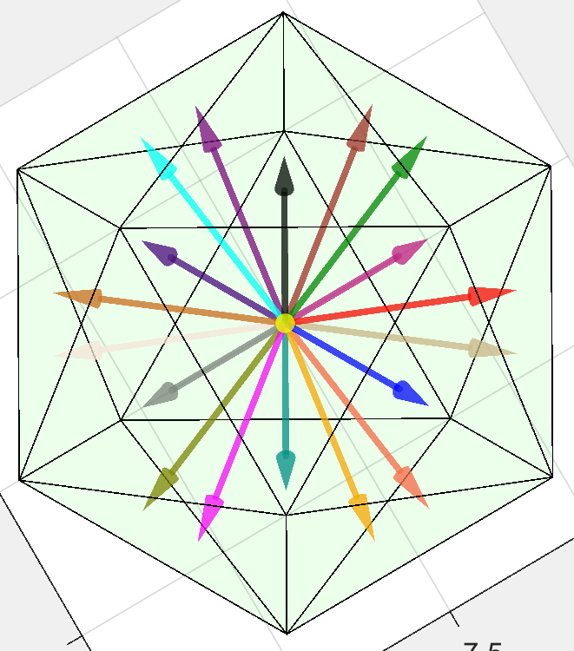
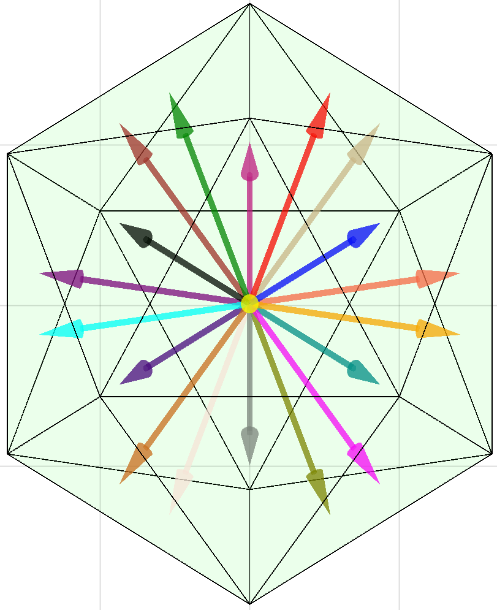
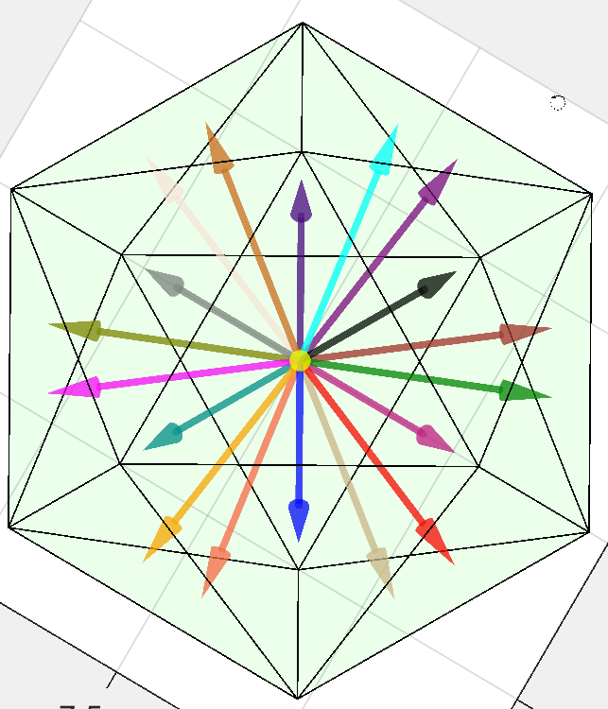
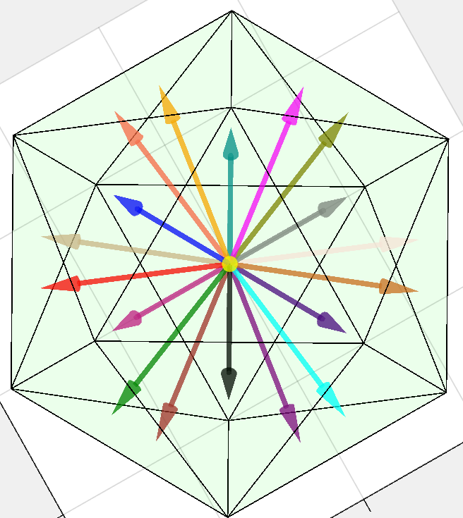
Gold11
Gold21
Gold31
Gold12
Gold22
Gold32

Slide 8
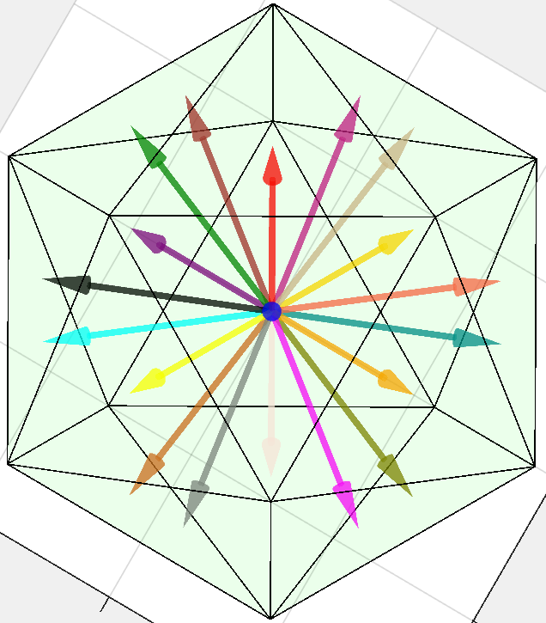
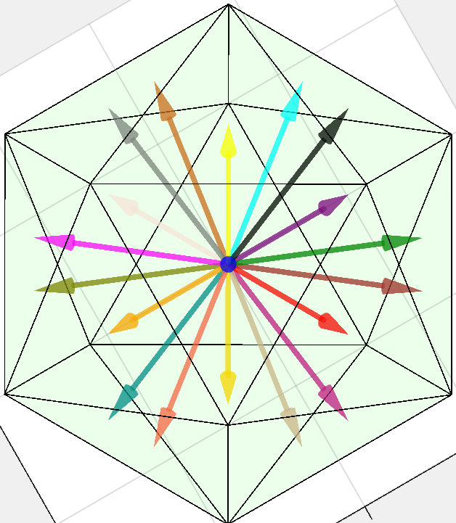
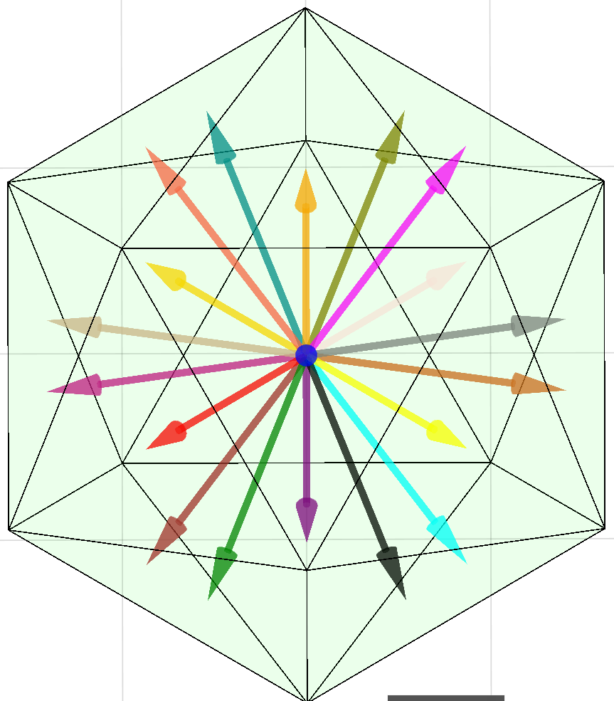
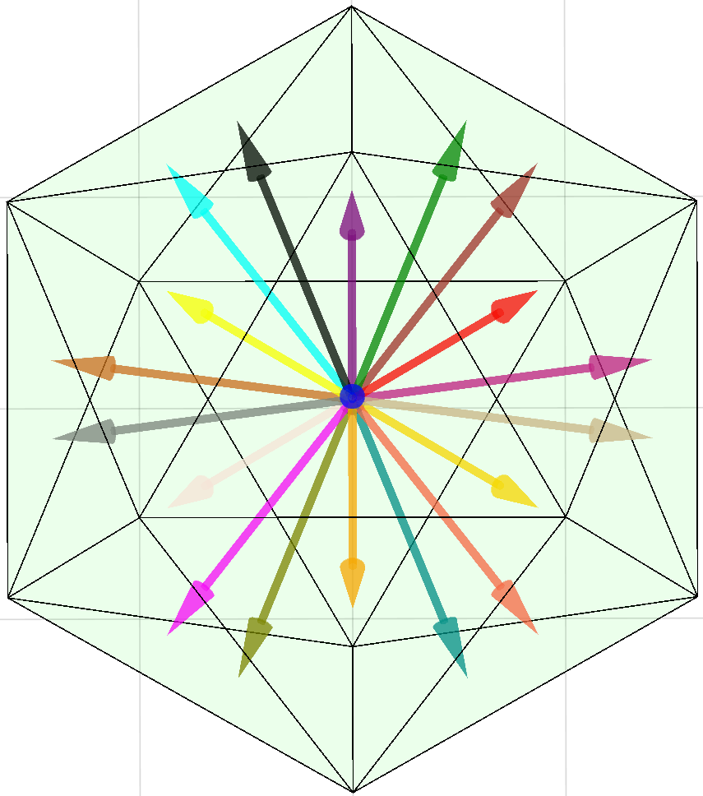
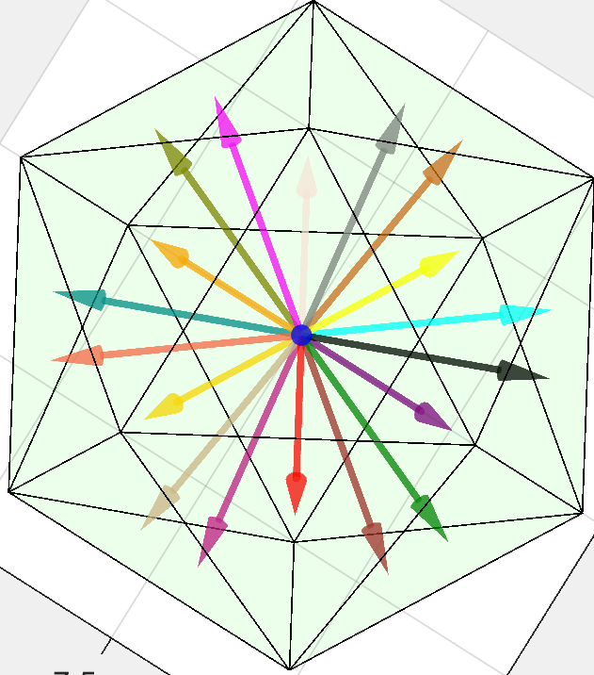
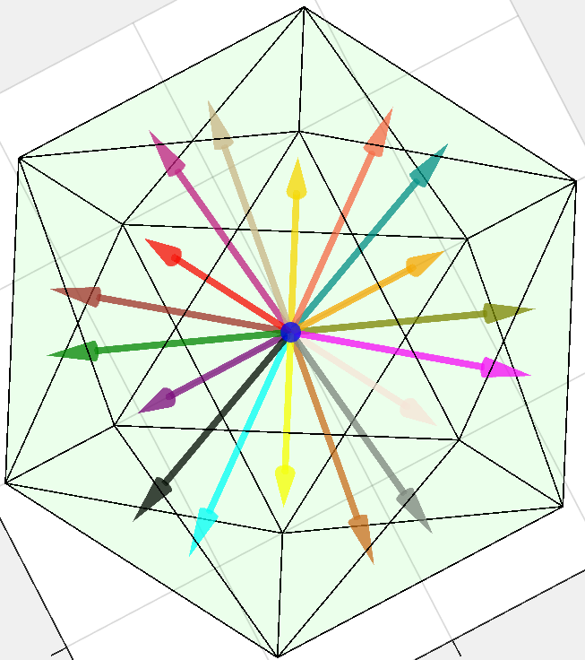
Indigo11
Indigo21
Indigo31
Indigo12
Indigo22
Indigo32

Slide 9
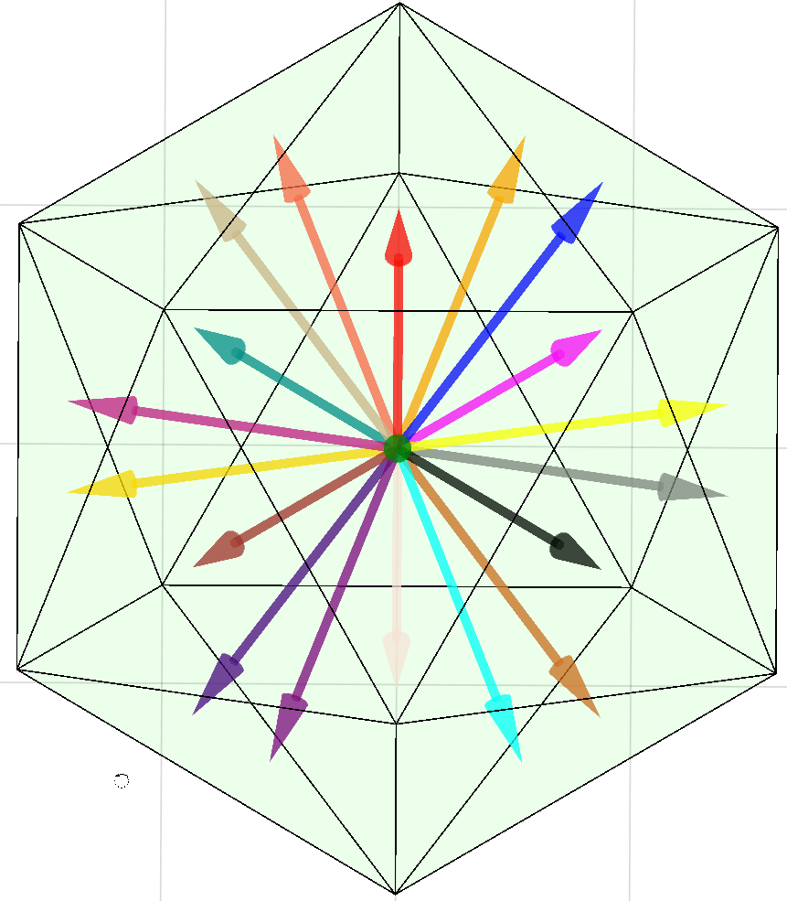
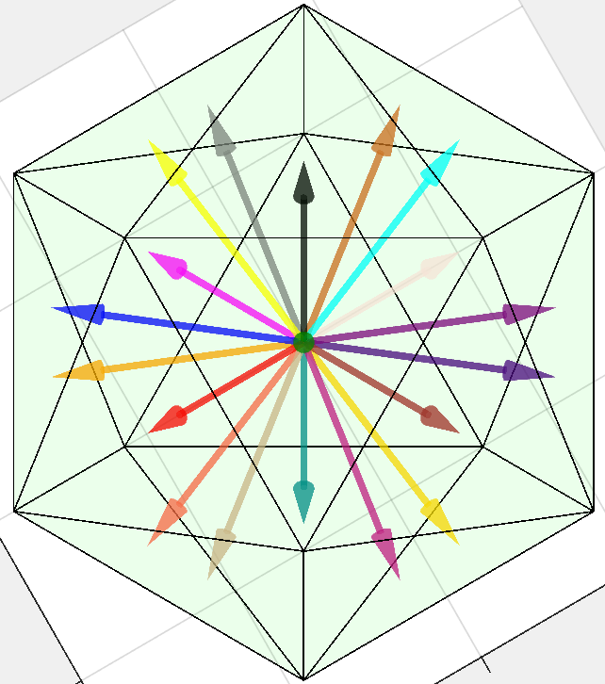
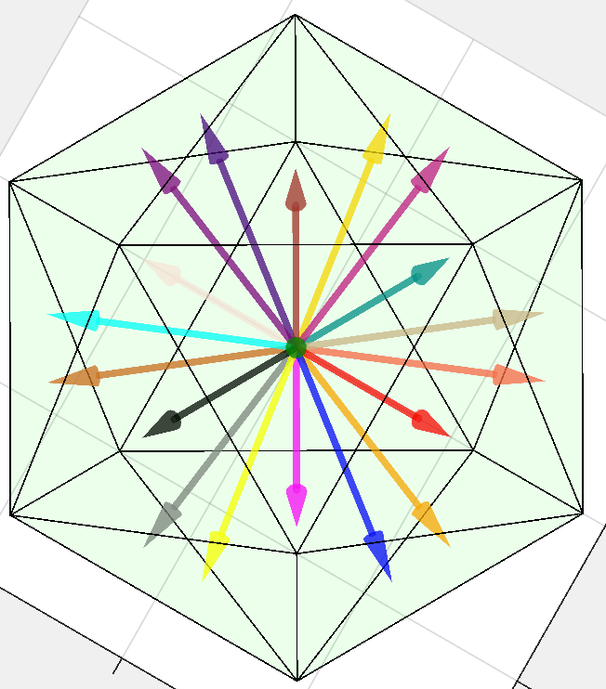
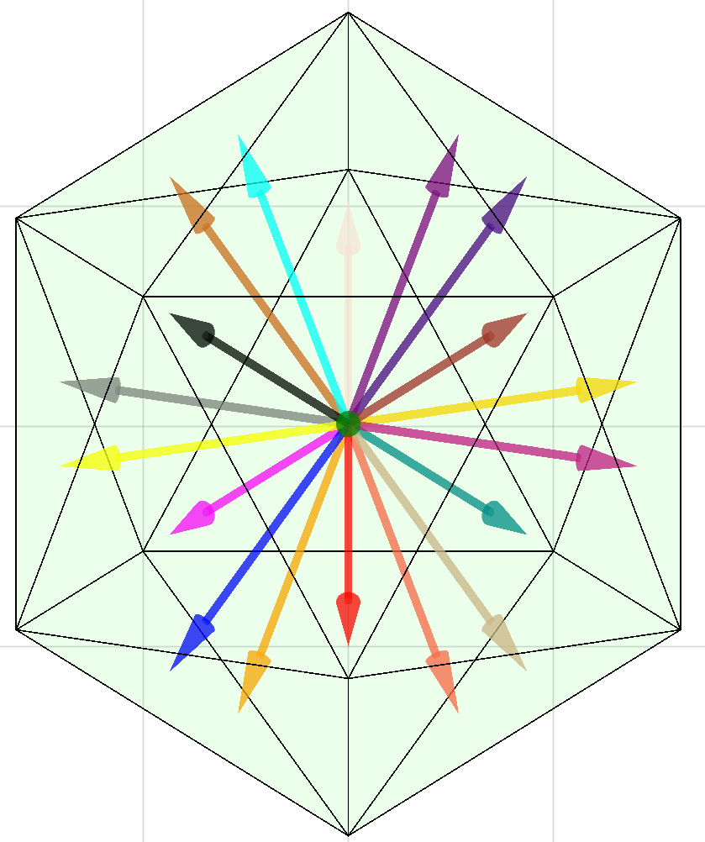
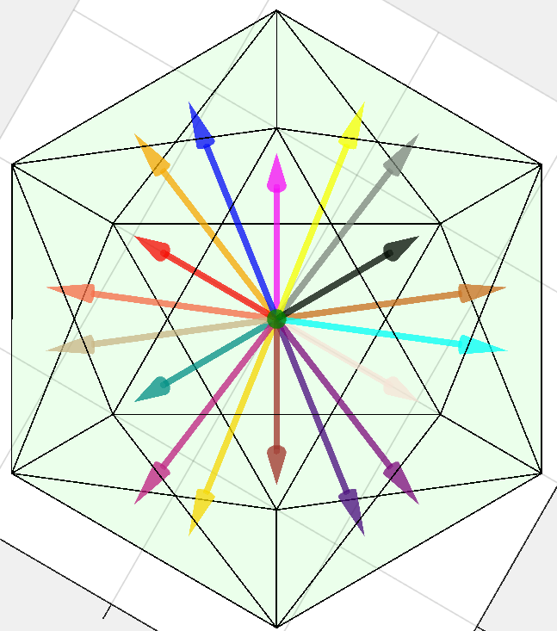
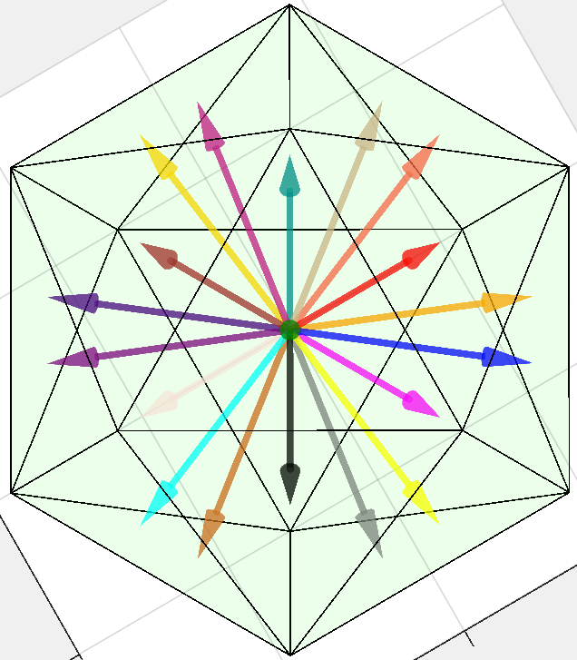
Olive11
Olive21
Olive31
Olive12
Olive22
Olive32

Slide 10
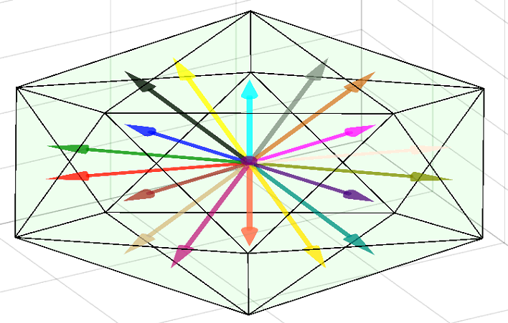





Orange11
Orange21
Orange31
Orange12
Orange22
Orange32

Slide 11






Tan11
Tan21
Tan31
Tan12
Tan22
Tan32

Slide 12






Tomato11
Tomato21
Tomato31
Tomato12
Tomato22
Tomato32

Slide 13






White11
White21
White31
White12
White22
White32

Slide 14






Yellow11
Yellow21
Yellow31
Yellow12
Yellow22
Yellow32

Slide 15






Pink11
Pink21
Pink31
Pink12
Pink22
Pink32

Slide 16






Purple11
Purple21
Purple31
Purple12
Purple22
Purple32

Slide 17

Blue11
Blue21
Blue31
Blue12
Blue22
Blue32

Slide 18


Black11
Black21
Black31
Black12
Black22
Black32

Slide 19




Brown11
Brown21
Brown31
Brown12
Brown22
Brown32

Slide 20

Choco11
Blue21
Blue31
Blue12
Blue22
Blue32

Slide 21

Blue11
Blue21
Blue31
Grey12
Blue22
Blue32

Slide 22

Blue11
Blue21
Blue31
DarkGreen12
Blue22
Blue32

Slide 23



